Slide 1
Capital Edge Australia
EDUCATE | CREATE | ACHIEVE

Slide 2
Who We Are
Australian firm specialising in residential property investment and getting into the property market
Proprietary property selection process and educational service to get you the right property
Educate – teaching everyday Aussies to build sustainable property wealth
Create – putting the building blocks in place to set you and your family up for the rest of your lives
Achieve – making the financial goals of our clients come true!
We Don’t Sell Property, We Help You Find The Right Property!

Slide 3
What We Do For You
We work with our network of real estate, finance & building professionals to ensure a tailored result for your needs.
Whether it’s a new or established build, we guide you through the entire real estate selection and acquisition process
From property selection, ensuring contracts are signed, selecting managing agents, selecting building inspectors, overseeing pre-handover, depreciation schedules and planning timelines for future purchases!

Slide 4
The Capital Edge Difference
Not a project marketer
Hold no stock – property selection specialists
Like a broker – no service payment (unless acting as a buyer’s agent)
All about education – Creating, Achieving & EDUCATING!

Slide 5
Our Foundation
For any house build or investment, a solid foundation is VITAL! Here at Capital Edge, our foundation is fourfold.
Goals & Destination
Process & Structure
Mentoring & Expertise
Partners & Collaborations

Slide 6
A Typical Property Investor
We work with those individuals and families wanting to purchase properties making an informed decision based on our selection criteria.
Our clientele covers all age groups, and includes single parents, pensioners and those looking to pass on generational wealth to their children!
We use a structured approach to ensure our clients and prospective investors are educated in the best approach for their needs.

Slide 7
Types Of Property
New Builds (off the plan)
Constructed/Under Construction
Established Properties

Slide 8
Approx Holding Costs - $600,000 house (example)
Purchase price | $600,000 (Land 200k, Build 400k)
Stamp Duty on a finished home in WA is $23,000 but on the land of $200,000 only $5,400)
80% loan | $480,000
Allow initial costs of around 4% for stamp duty, legal fees and interest during construction.
Interest @6% (IO) | $28,800
Rates | $2,500
Insurance | $1,500
Management fees | $2,500
Total costs | $35,300
Costs
Income
Rent @$580 per week | $30,160
Less total Costs | $35,300
Loss | $5,140 or $98 per week.

Slide 9
Approx Holding Costs - $600,000 house (example)
At tax time (Tax rate depends on income)
Income (rent) $30,160
Less costs $35,300
Loss (out of pocket) $5,140
Depreciation 40 years structure $8,000
Depreciation fixtures and fittings $9,000
(First 6 years)
Total loss for tax purposes $22,140
If marginal tax rate is 37%
Tax return at this rate $8,191 back at tax time

Slide 10
Rentvesting
What Is It?
Benefits
Risks/Downside

Slide 11
Rentvesting – What Is It?
Rentvesting is a home-owning strategy where you rent a property to live in that’s right for your lifestyle, while buying an investment property that’s right for your budget.
Great for getting into the property market.
Rentvesters rent a third-party’s property in an area they want to live in (but where they can’t afford to buy e.g., inner city) and buy a property they can afford (but don’t want to live, e.g., outer suburbs) to rent out as an investment property.

Slide 12
Rentvesting - Benefits
Rentvesting has several benefits, including:
The ability to live where you want, even if you can't afford to buy in that area.
Renting accommodation close to the city or beaches can be more affordable than buying in those areas.
Rentvesting allows you to buy a property purely from an investment perspective, focusing on capital growth and rental yield instead of how much you love the location.
Rentvesting can help you climb the real estate ladder much quicker as you get into the market earlier.
The income from your purchased properties can be used to help pay your rent.
Rentvesting allows you to keep renting as the value of your investment property increases.

Slide 13
Rentvesting – Risks/Downside
Rentvesting has several benefits, including:
The ability to live where you want, even if you can't afford to buy in that area.
Renting accommodation close to the city or beaches can be more affordable than buying in those areas.
Rentvesting allows you to buy a property purely from an investment perspective, focusing on capital growth and rental yield instead of how much you love the location.
Rentvesting can help you climb the real estate ladder much quicker as you get into the market earlier.
The income from your purchased properties can be used to help pay your rent.
Rentvesting allows you to keep renting as the value of your investment property increases.

Slide 14
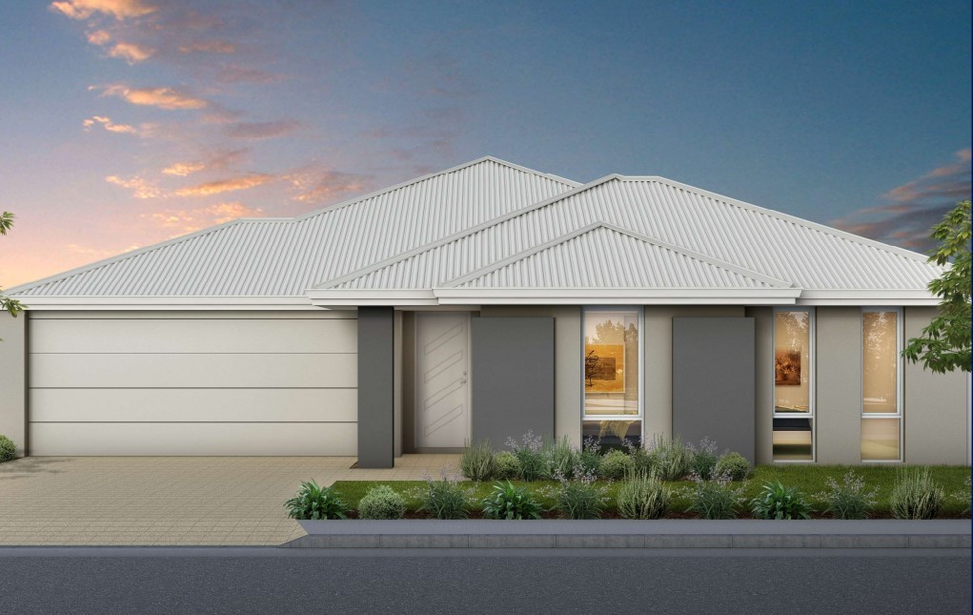
Case Study/Example – Emma & Brad
Renting in Mentone (priced out of the market)
Approached Capital Edge for options
Saved $70,000
Purchased first investment property in
Eglinton, WA for $527k (rent $550)
Seeking 2nd property with equity growth in
the years ahead.

Slide 15
Guarantor Loans
What Are They?
Benefits
Risks/Downside

Slide 16
Guarantor Loans – What Are They?
A guarantor loan is a type of loan where a third party, known as a guarantor, promises to pay the debt of the borrower in case of default on their financial obligation. Essentially, a guarantor secures someone’s loan by committing to pay the loan if the borrower fails to pay it.
Often a family member, a guarantor loan is a great way younger Australians and first-time home buyers are getting into their properties faster.

Slide 17
Guarantor Loans – Benefits
Increased borrowing capacity: With a guarantor, some lenders may view a borrower's application as a lower risk and be more inclined to lend, or lend a higher amount
Lower interest rates: Having a guarantor can allow for borrowing more and receiving a better interest rate
Ability to purchase property sooner: A guarantor allows you to purchase a property sooner and potentially save thousands of dollars
Helps improve credit history: A guarantor loan can help the borrower improve their credit history
Easier loan approval: Having a guarantor means that the loan or agreement has a higher chance of being approved and much more quickly

Slide 18
Guarantor Loans – Risks/Downsides
Long-term commitment: Being locked into someone else’s loan as a guarantor could impact your own financial situation in the long-term
Risk to credit score: If the borrower defaults or misses repayments on their loan, being a guarantor could negatively impact your credit score resulting in your own future loan applications being turned down
Legal obligation: When you become a guarantor, you are entering into a contract with the lender that is legally binding. If the borrower fails to make the required payments, then the lender may recover the loan from the guarantor
Impact on future loan prospects: Being a guarantor for someone else’s loan could affect your own future loan prospects

Slide 19
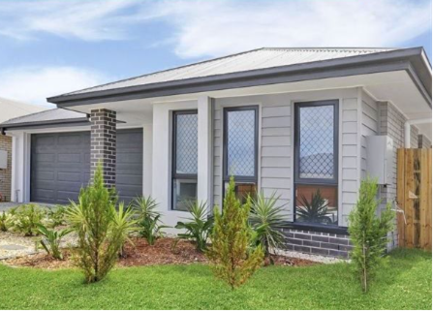
Case Study - Michelle
Got a guarantor loan from Mum
Purchased Palmview, QLD (see picture) for
$500k (rent $480)
3 Years Later – valued at $800k (rent $650)
Guarantor removed
Equity Release & 2nd property
purchased in Kuraby, QLD

Slide 20
Beyond Your Backyard
Western Australia
Queensland
South Australia
Victoria
At Capital Edge, we don’t focus on one suburb or one neighbourhood, we really are Australia-wide!

Slide 21
Victoria
Population Growth
Biggest Capital City
Infrastructure
Capital Growth
Consistent Liveability
Strong Economy
BUT
Poor Rent Returns
Land tax threshold has dropped
High debt levels
More conservative approach to purchasing

Slide 22
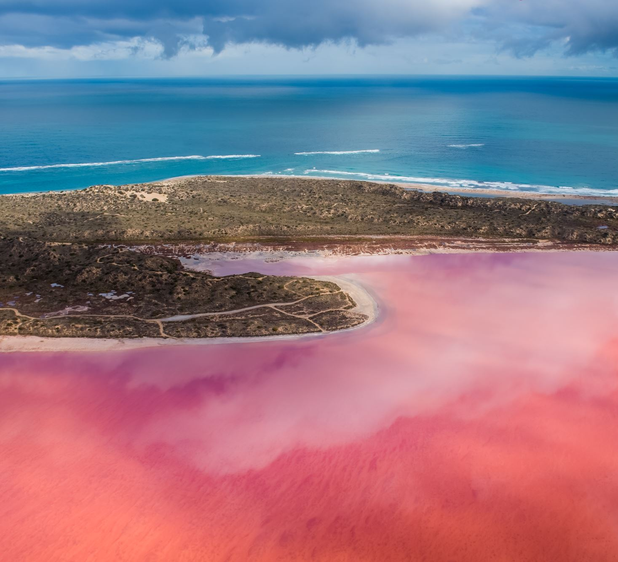
Western Australia
MetroNet Upgrade & 1.3B spent on metro roads & 5.3B on regional roads
Affordability
Government Spending & Infrastructure
High Rent Returns
Strong Capital Growth & Property Cycle
Low Vacancy Rate
Net Migration from other states (anticipated 1.5%)

Slide 23
Queensland
2032 Olympics
Educational Spending (schools)
Net Migration from other states & countries, resulting in strong population growth
Lifestyle (GC, Brisbane & Sunshine Coast)
Infrastructure & Government Spending
Economic Growth has exceeded national average

Slide 24
South Australia
Adelaide is the world’s THIRD most liveable city
Housing under-supply
Low Vacancy Rate of 0.4%
Infrastructure & Government Spending (including 1B in CBD)
Committed to the new hospital in the CBD
Huge defence investment
Property Cycle

Slide 25
The Property Mountain
The Property Mountain represents the journey of property ownership and management.
It symbolises the various stages, challenges, and opportunities encountered along the way
Capital Edge begins at base camp with our education sessions and our summit is handover.
We CLIMB, SIDE-BY-SIDE, WITH YOU, ALL THE WAY!

Slide 26
Our Property & Selection Criteria!
Simply put, we don’t present it if we wouldn’t buy it for ourselves!
We look at EVERYTHING when it comes to choosing opportunities for you
Vacancy Rates
Hotspots
Property Cycle
Median House Price
Median Rent
Rental Population
Services & Facilities (schools, higher education
medical, dining
entertainment, shopping, recreation & transport)
Titled Land
Proximity to major cities and social hubs

Slide 27
Building Your Team Of Experts
All overseen by Capital Edge!
Property Accountant
Conveyancer/Solicitor
Independent Building Inspectors
Financial Planner
Mortgage Broker
Depreciation Experts
Property Manager
Capital Edge

Slide 28
The Wealth Checklist
How do you know you’re interested in property? In our experience, if you can cover three things in our checklist, you need to be talking to us!
Build personal wealth
Being self-sufficient in retirement
Passionate about property
Achieving tax benefits
Having financial peace of mind
Passing down assets
Helping children and grandchildren
Achieving passive income
Diversifying investments

Slide 29
Contact Capital Edge! (Jono – 0413 599 936)
Facebook & LinkedIn – Capital Edge Australia
Website – capitaledgeaustralia.com.au
Phone –
1300 976 030
CREATE – EDUCATE - ACHIEVE

